Slide 1
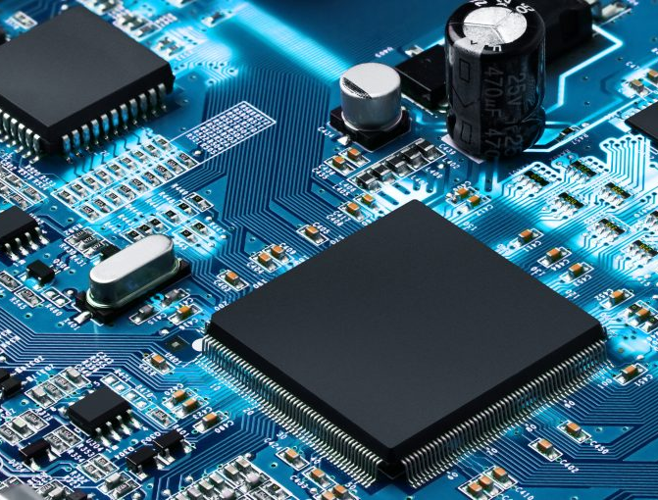



PEMROSESAN PARALEL
CCE60218

Slide 2
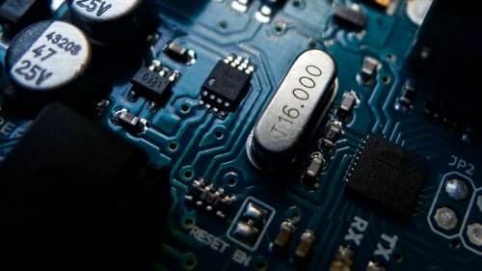
Multiprocessing & Data Communication Between Process

Slide 3
Multiprocessing
Multiprocessing refers to the ability of a system to support more than one processor at the same time. Applications in a multiprocessing system are broken to smaller routines that run independently.
Process
Sub-process 1
Sub-process 2
Sub-process 3
time

Slide 4
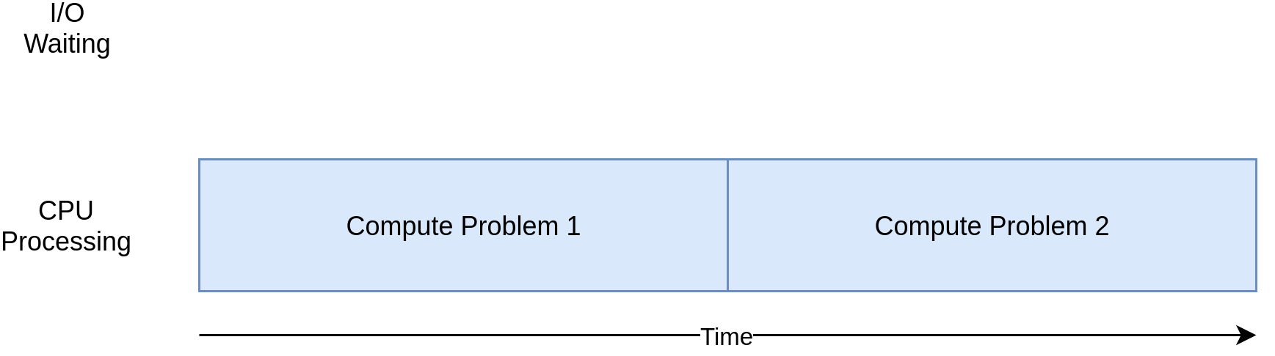
CPU-Bound Process

Slide 5
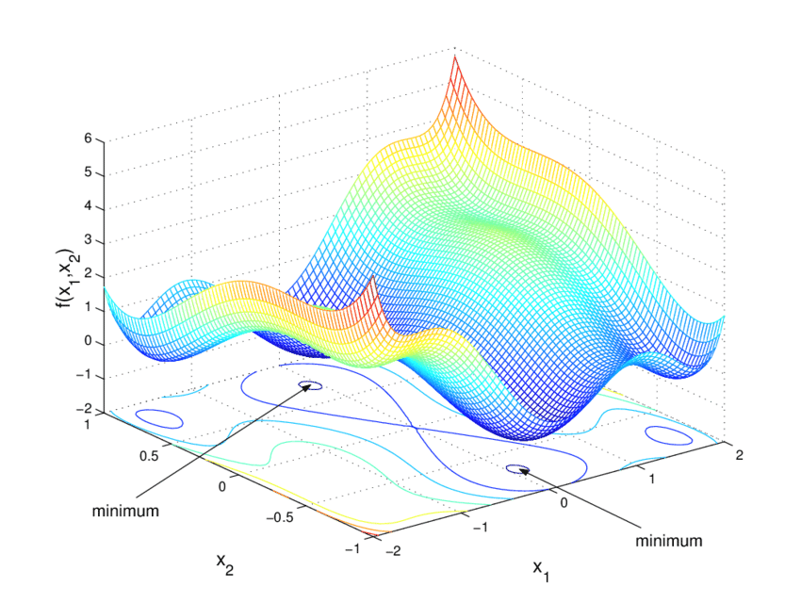
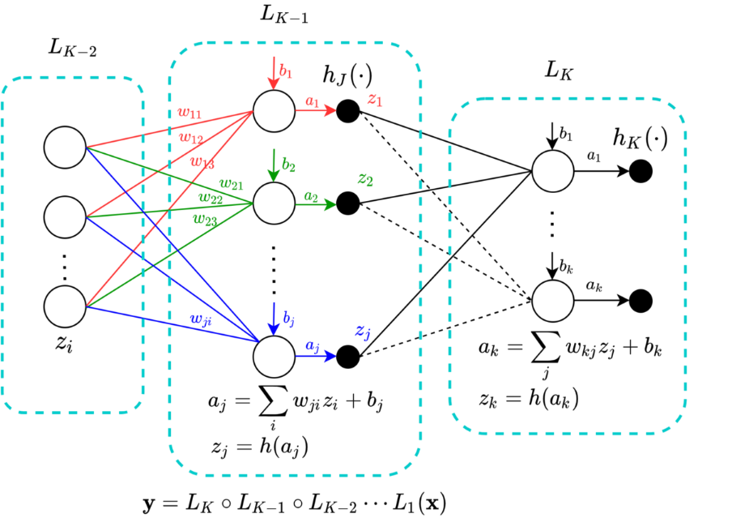
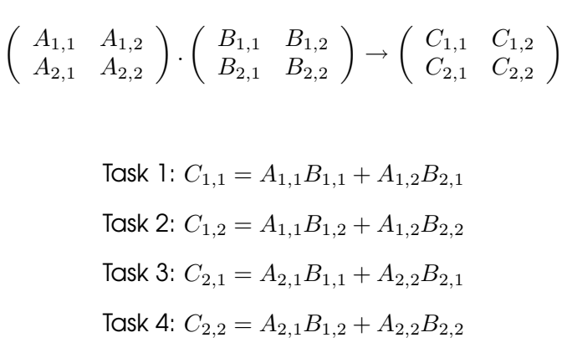
Example
ANN Training (Back Propagation)
Numerical Optimization
Matrices Multiplication

Slide 6
Example
A
x
Serial
Buatlah algoritma dalam bentuk pseudococe untuk chained matrices multiplication:
Y = A x B x C x D x E x F x G x H.
dimana
Y, A, B, C, D, E, F, G, dan H adalah matriks 5 x 5
B
x
C
x
D
x
E
x
F
x
G
x
Y
H
t

Slide 7
Example
A
x
Parallel
Buatlah algoritma dalam bentuk pseudococe untuk chained matrices multiplication:
Y = A x B x C x D x E x F x G x H.
dimana
Y, A, B, C, D, E, F, G, dan H adalah matriks 5 x 5
B
x
C
x
D
x
Y
E
x
F
x
G
x
H
t

Slide 8
Example
A
p1
Buatlah algoritma dalam bentuk pseudococe untuk chained matrices multiplication:
Y = A x B x C x D x E x F x G x H.
dimana
Y, A, B, C, D, E, F, G, dan H adalah matriks 5 x 5
x
B
x
C
p2
x
D
x
Y
E
p3
x
F
p4
x
G
x
H
t

Slide 9
Example
A
p1
Buatlah algoritma dalam bentuk pseudococe untuk chained matrices multiplication:
Y = A x B x C x D x E x F x G x H.
dimana
Y, A, B, C, D, E, F, G, dan H adalah matriks 5 x 5
x
B
p5
x
C
p2
x
D
x
Y
E
p3
x
F
p4
x
G
p6
x
H
t

Slide 10
Example
Data communication between process
A
p1
Buatlah algoritma dalam bentuk pseudococe untuk chained matrices multiplication:
Y = A x B x C x D x E x F x G x H.
dimana
Y, A, B, C, D, E, F, G, dan H adalah matriks 5 x 5
x
B
p5
x
C
p2
x
D
x
Y
E
p3
x
F
p4
x
G
p6
x
Data communication between process
H
t

Slide 11
Example
Data communication between process
A
p1
Buatlah algoritma dalam bentuk pseudococe untuk chained matrices multiplication:
Y = A x B x C x D x E x F x G x H.
dimana
Y, A, B, C, D, E, F, G, dan H adalah matriks 5 x 5
x
B
p5
Data communication between process
x
C
p2
x
p7
D
x
Y
E
p3
x
F
p4
x
G
p6
x
Data communication between process
H
t

Slide 12
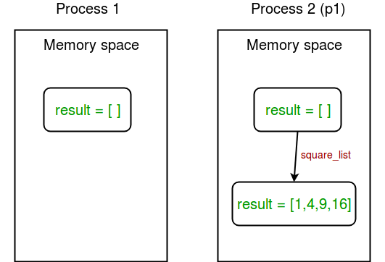
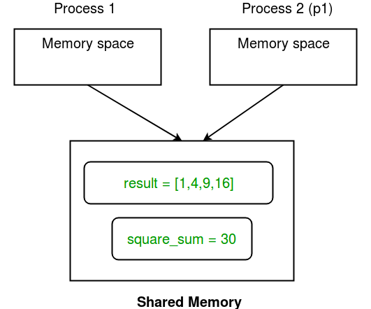
Data Communication Between Process
Shared Memory: multiprocessing module provides Array and Value objects to share data between processes.
Array: a ctypes array allocated from shared memory:
Value: a ctypes object allocated from shared memory:
multiprocessing.Array('i', 4)
multiprocessing.Value('i')

Slide 13
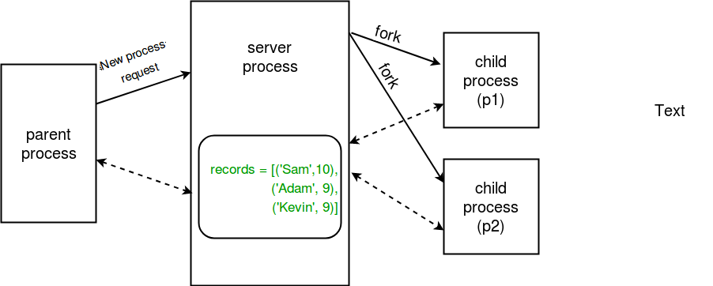
Data Communication Between Process
Server process : Whenever a python program starts, a server process is also started. From there on, whenever a new process is needed, the parent process connects to the server and requests it to fork a new process. A server process can hold Python objects and allows other processes to manipulate them using proxies.

Slide 14

Terima Kasih

